Slide 1

Using Machine Learning to Predict Factors Leading to Employee Attrition
Tom Kim
May 10, 2023
Notes:
Alex
Hello and welcome, my name is Alex joined by the rest of my team: Kristina, Aurora, Tom, and Marc … our presentation will examine employee data through Machine Learning for foresight concentration,.

Slide 2




Overarching goal and analysis approach
How we’ll get there
A multi-phased statistical approach to uncovering the richest insight
Our Goal
Identify Canterra’s probability of attrition, understand the factors impacting turnover and recommended changes to encourage employees to stay in the workplace.
Logistic
Regression
Explains the relationship between one dependent variable (attrition) and several independent variables in the dataset
Classification Decision Tree
Assesses structurally the binary decisions that lead to employee attrition
Bootstrap Aggregation “Bagging”
Curtails variance by creating multiple trees and taking a majority vote for the most common class among predictors of attrition
Random
Forest
Implements diversity in the bootstrap aggregated model to reduce and remove correlation in attrition trees
Notes:
Alex
Discuss Overall Goal
Logistic Regression explains probability of Attrition based upon independent variables in the data and the Decision Tree determines the predictive value based on series of questions and conditions.
Bootstrap Aggregating Trees otherwise referred to as 'bagging' and random forest models are called “ensemble models” which combines several base models in order to produce one ultimate predictive model
Random Forests are an enhancement on bagging by splitting the trees based on different features
Now Kristina will discuss how we identified the best model

Slide 3


Identifying the best model and understanding its performance power in predicting attrition
Measures of Model Performance
(Based on all Models)
Interpretation of the Random Forest Model
(Based on Random Forest Model)
Model | AUC-ROC | Sensitivity | Accuracy | Specificity
Decision Tree Model | 68% | 57% | 72% | 75%
Logistic Regression Model | 73% | 69% | 65% | 64%
Extended Bagging Model | 52% | 89% | 80% | 78%
Random Forest Model | 98% | 96% | 91% | 90%
98%
chance
the random forest model can distinguish between positive versus negative attrition classes
Less Optimal Model
9 in 10
96%
the random forest model can successfully identify whether an employee is predicted to resign or stay
the random forest model has a high probability of identifying employees who actually left Canterra
Most Optimal Model
Notes:
Kristina
Voice track: We need to explain in simple words what all the metrics mean(sensitivity, accuracy, AUC ect). How Sensitivity and AUC are the most important

Slide 4
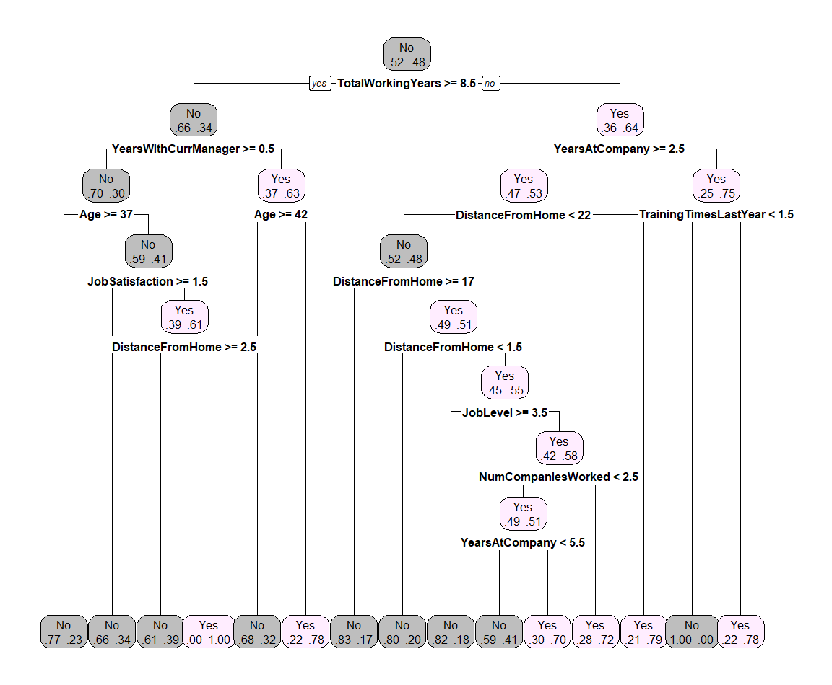



Professional experience, tenure with the company and years with current manager impact attrition in decision tree model
Decision
Tree
Top Predictors of Attrition
(Based on Decision Tree Model)
Decision Tree Factors of Attrition
(Based on Decision Tree Model)
Total Working Years
(based on more/less than 8.5 years)
Years with Current Manager
(based on more/less than 0.5 years)
Years at Company
(based on more/less than 2.5 years)
Notes:
Aurora

Slide 5



Logit highlights categorical factors such as frequent business travel, single status, and tenure predicting attrition
Logistic Regression
Top Predictors of Attrition
(Based on Logistic Regression Model)
524%
Business Travel Frequently*
(73:1 odd ratio)
Increase in the probability of attrition among employees who frequently travel for business*
270%
Marital Status Single*
(68:1 odd ratio)
Increase in the probability of attrition among employees who are of single status*
12%
Years at Company
(84:1 odd ratio)
Increase in the probability of attrition for each year that an employee works at Canterra
* Please note these findings are based on comparable results; 1) compared to employees who travel rarely; 2) compared to employees who are divorced
Notes:
Aurora

Slide 6
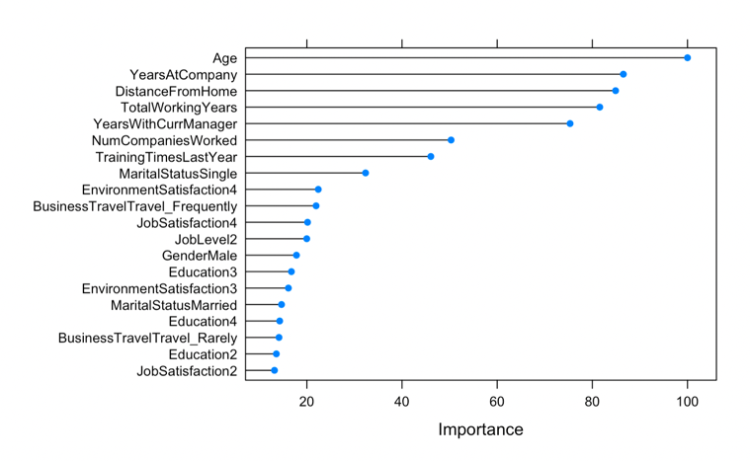

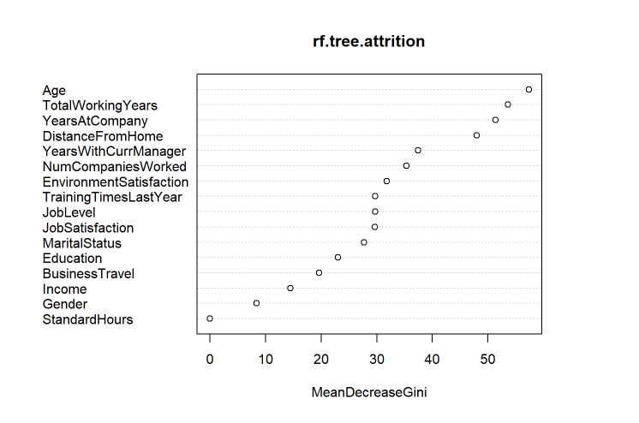



Age, working years, company tenure and commute play a role in retaining talent with bagging and random forest modeling
Bagging & Random Forest
Top Predictors of Attrition
(Based on Bagging and Random Forest Models)
Top Variables of Attrition
(Based on Bagging Model)
Top Variables of Attrition
(Based on Random Forest Model)
Age
Age
Total Working Years
Total Working Years
Years at Company
Years at Company
Distance from Home
Distance from Home
Importance
Mean of Gini Index
Notes:
Tom
Single tree models suffer from high variance
Bootstrap Aggregating (bagging) combines and averages multiple models(reduces variability and overfitting)
Random Forest: Improves on bagging, it performs bagging and also randomly subsets the variables by forcing each tree to do different splits, capturing all the ways of modeling the data

Slide 7




Overall, the random forest algorithm predicts attrition best, with directional insights from decision tree modeling
Top Predictors of Attrition
(Based Random Forest Model)
Decision Tree Factors of Attrition
(Based on Decision Tree Model)
Age
Total Working Years
Years at Company
Distance from Home
Notes:
Tom

Slide 8



Recommendations for improving retention at Canterra
Finding
Proposed
Recommendations
Actions for the
Initial 30-60 days
1
Younger to middle-aged employees are the greatest at-risk group to leave Canterra.
Preemptively deter attrition by offering robust professional development opportunities, career growth maps and competitive pay.
Implement quarterly check-ins for all staff
Share career roadmaps based on job level
Review salaries and develop a plan for meeting/exceeding industry standards
2
Staff with less professional working years tend to seek opportunities elsewhere.
Place greater rigor in vetting candidates by placing greater emphasis in understanding their long-term goals to ensure alignment with Canterra.
Train interviewers/managers on asking goal-oriented questions in interview process
Align incoming employees to departments and disciplines that support long-term professional growth
3
Yet, tenure at the company also plays a role in driving attrition.
Institute a reward-and-recognition program for longstanding employees to incentivize commitment.
Share monthly recognition emails for employee anniversaries
Develop a reward program such as sabbatical or additional PTO for seasoned employees
4
Distance from work matters – with greater commute times comes greater attrition.
Implement flexible work from home policy to mitigate stress and inconvenient travel for long-distance employees.
Encourage employees to have 1-2 work from home days on a weekly basis
Provide a light stipend for employees to purchase items for a home office set-up
5
The random forest model can most accurately (91%) distinguish between employees who will retain versus leave.
Leverage the random forest model to identify current at-risk employees as well as to vet incoming, prospective candidates.
Assess which current employees fit criteria and host discovery sessions to gauge overall satisfaction
Train human resources are the prominent factors to closely assess when vetting candidates
Notes:
Marc

Slide 9


Thank You

